Slide 1
Big Data in R

Slide 2
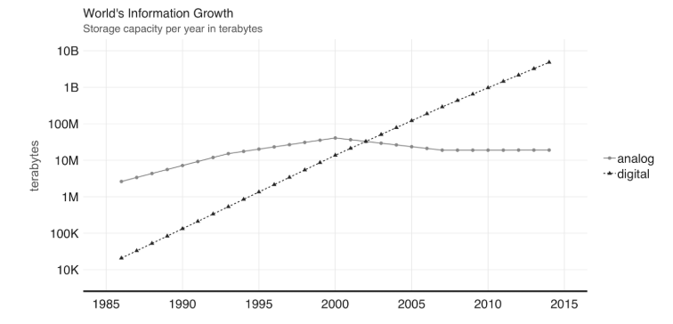
Data Storage
Notes:
The world bank report on digital development provides an estimate of digital and analog information stored over the last decades. (Group 2016) This report noted that digital information surpassed analog information around 2003. At that time, there were about 10 million terabytes of digital information, which is roughly about 10 million storage drives today. However, a more relevant finding from this report was that our footprint of digital information is growing at exponential rates. Figure shows the findings of this report, notice that every other year, the world’s information has grown tenfold.

Slide 3
“Apache Spark is a unified analytics engine for large-scale data processing.” -spark.apache.org
Unified:
Spark supports many libraries, clusters technologies and storage systems.
Analytics:
Analytics is the discovery and interpretation of data to produce and communicate information.
Engine:
Spark is expected to be efficient and generic.
Large-Scale:
One can interpret large-scale as cluster-scale, a set of connected computers working together.
Notes:
Spark is described as an engine since it’s generic and efficient, it optimizes and executes generic code; there are no restrictions as to what type of code one can write in Spark. It is also quite efficient, as we mentioned, Spark is much faster than other technologies by making efficient use of memory, network and CPUs to speed data processing algorithms in computing clusters.

Slide 4
Big Data
Big data and big compute problems are usually easy to spot – if the data does not fit into a single machine, you might have a big data problem; if the data fits into a single machine but processing it takes days, weeks or even months to compute, you might have a big compute problem.
There are a few use cases this breaks to:
Velocity
Variety
Veracity

Slide 5
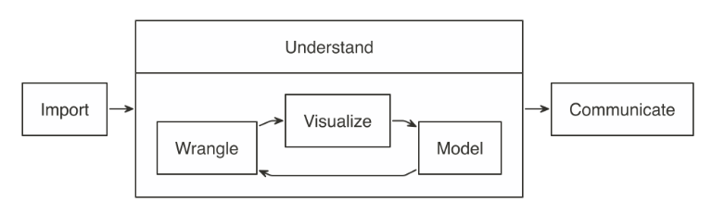
Principle
In a data analysis project, the main goal is to understand what the data is trying to “tell us”, hoping that it provides an answer to a specific question.
Most data analysis projects follow a set of steps
Notes:
We first import data into our analysis stem, then wrangled by trying different data transformations, such as aggregations, and then visualized to help us perceive relationships and trends. In order to get deeper insight, one or multiple statistical models can be fitted against sample data. This will help in finding out if the patterns hold true when new data is applied to them. And lastly, the results are communicated publicly or privately to colleagues and stakeholders.

Slide 6
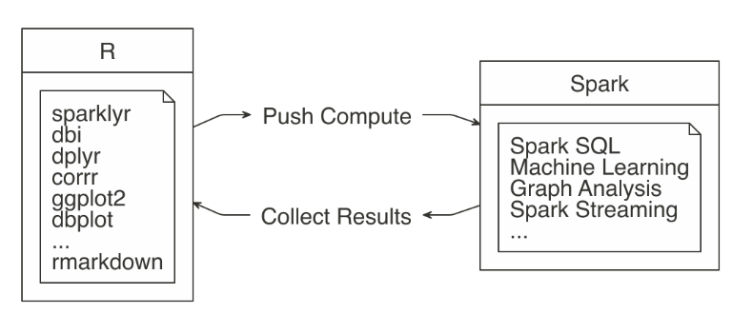
Principle(cont.)
When working with not-large-scale datasets, as in datasets that fit in memory; we can perform all those steps from R, without using Spark.
However, when data does not fit in memory or computation is simply too-slow, we can slightly modify this approach by incorporating Spark

Slide 7
Apache Spark
Spark is a parallel computation engine that works at a large-scale and provides a SQL engine and modeling libraries. These can be used to perform most of the same operations R performs.
Such operations include data selection, transformation, and modeling. Additionally, Spark includes Graph analysis and Streaming libraries and many other.
Data import, wrangling, and modeling can be performed inside Spark.
Visualization can also partly be done by Spark.
The idea is to use R to tell Spark what data operations to run, and then only bring the results into R.

Slide 8
Apache Spark with R
Spark computes while R collects results||analysis-approach.
The “sparklyr” package aids in using the “push compute, collect results” principle.

Slide 9
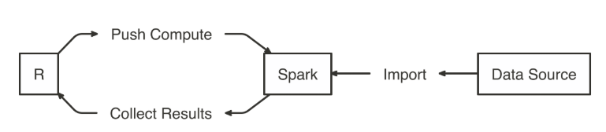
Import
Import Data to Spark not R

Slide 10
Wrangle
Data wrangling uses transformations to understand the data, it is often referred to as the process of transforming data from one “raw” data form into another format with the intent of making it more appropriate for data analysis.
Malformed or missing values and columns with multiple attributes are common data problems you might need to fix, since they prevent you from understanding your dataset.
After the data is cleaned, you still need to understand the basics about its content. Other transformations, such as aggregations, can help with this task.

Slide 11
Wrangle (cont.)
The main goal is to write the data transformations using R syntax as much as possible.
This saves us from the cognitive cost of having to switch between multiple computer technologies to accomplish a single task.
In this case, it is better to take advantage of “dplyr”, instead of writing Spark SQL statements for data exploration.

Slide 12
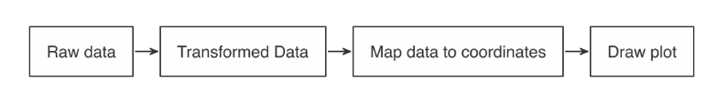
Visualize
Visualizations are a vital tool to help us find patterns in the data. It is easier for us to identify outliers in a data set of 1,000 observations when plotted in a graph, as opposed to reading them from a list.
R is great at data visualizations. Its capabilities for creating plots is extended by the many R packages that focus on this analysis step.
It is possible to create visualizations in R from data source from Spark. To understand how to do this, let’s first break down how computer programs build plots – see figure
Stages of an R plot||analysis-plot
Notes:
To understand how to do this, let’s first break down how computer programs build plots: It takes the raw data and performs some sort of transformation. The transformed data is then mapped to a set of coordinates. Finally, the mapped values are drawn in a plot.

Slide 13
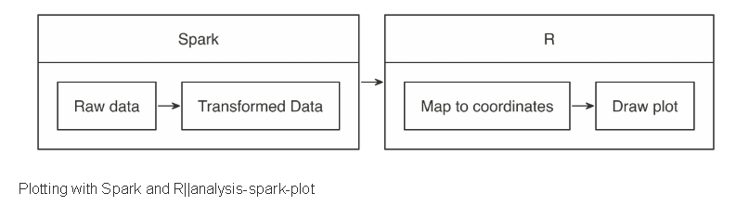
Visualize (cont.)
The approach for visualizing is the same as in wrangling, push the computation to Spark, and then collect the results in R for plotting.
The heavy lifting of preparing the data, such as in aggregating the data by groups or bins, can be done inside Spark, and then collect the much smaller data set into R. Inside R, the plot becomes a more basic operation.

Slide 14
Model
An analysis project goes through as many transformations and models to find the answer.
That’s why the first data analysis diagram we introduced, illustrates a cycle between: visualizing, wrangling and modeling – we know you don’t end with modeling, not in R and neither when using Spark.
Therefore, the ideal data analysis language enables you to quickly adjust over each wrangle-visualize-model iteration. Fortunately, this is the case when using Spark and R.

Slide 15
Communicate
It is important to clearly communicate the analysis results – as important as the analysis work itself! The public, colleagues or stakeholders need to understand what you found out and how.
To communicate effectively we need to use artifacts, such as reports and presentations; these are common output formats that we can create in R, using R Markdown.

Slide 16
R code Example
Dataset – Iris
Library
sparklyr
dbplot
dplyr
Spark Functions
sdf_
ml_

Slide 17
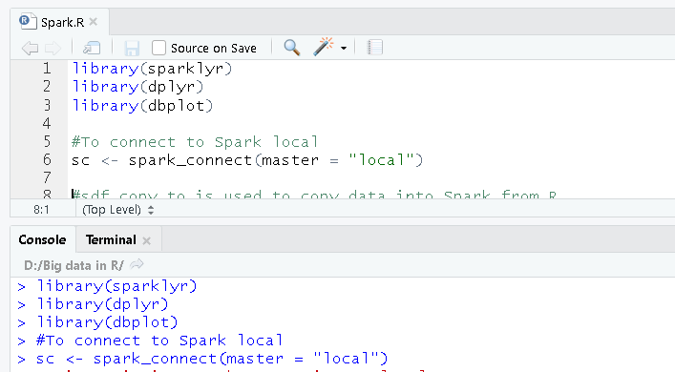
Loading Libraries
spark_connect: Function to connect R with Spark

Slide 18
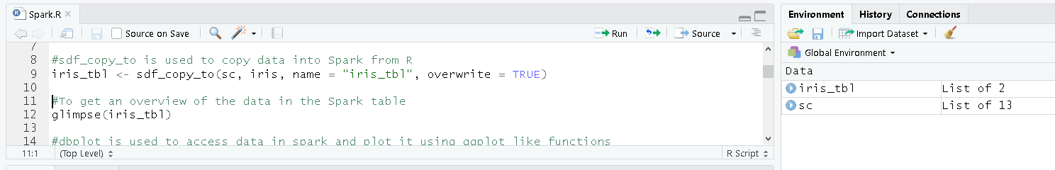
Load data into Spark
sdf_copy_to: Function to copy data into Spark from R

Slide 19
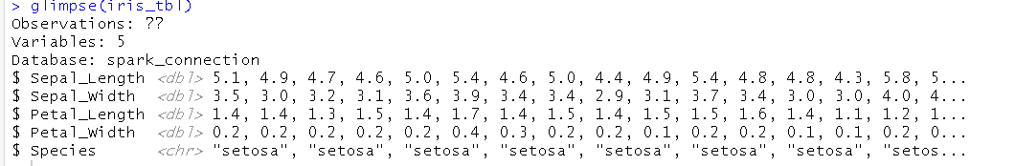
To view the data in Spark
Glimpse: Function to view the data. It is like str()

Slide 20
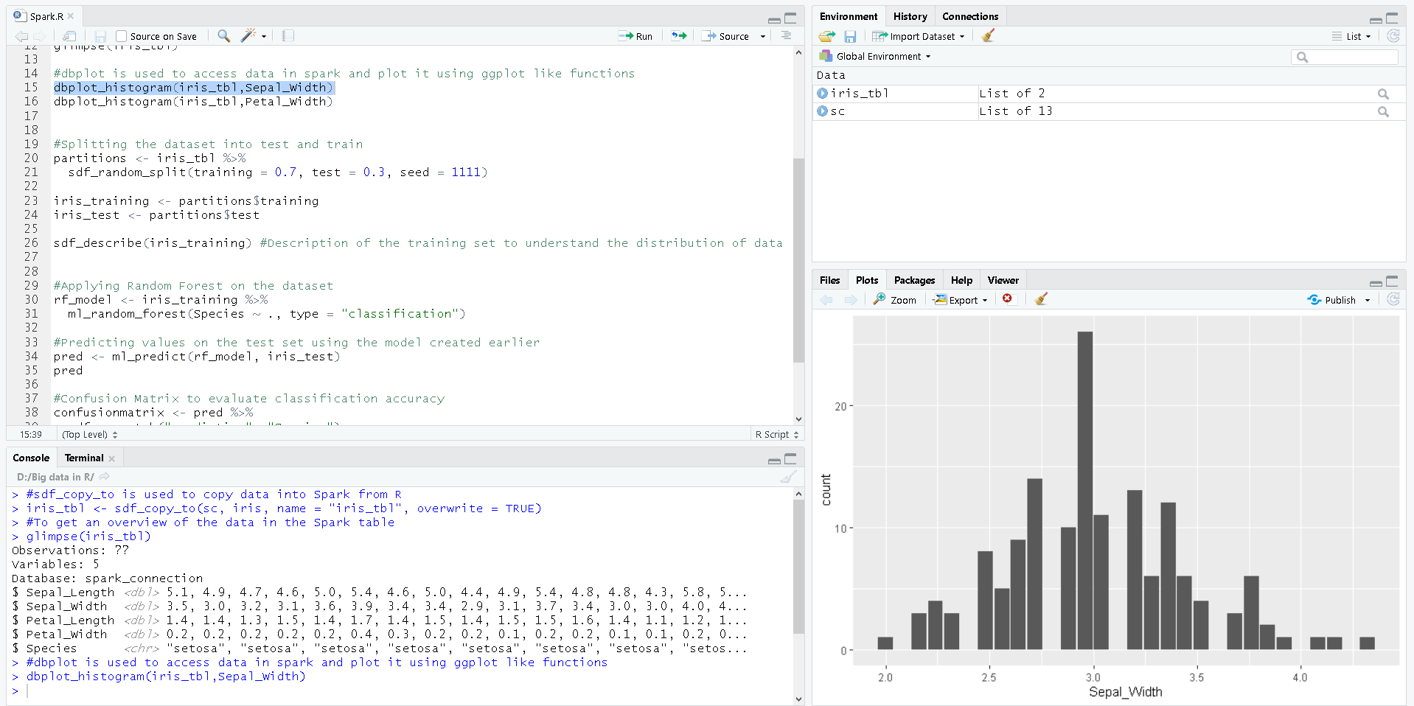
Exploratory Analysis
dbplot: Function used to make Spark compute the parameters for plotting and output like ggplot

Slide 21
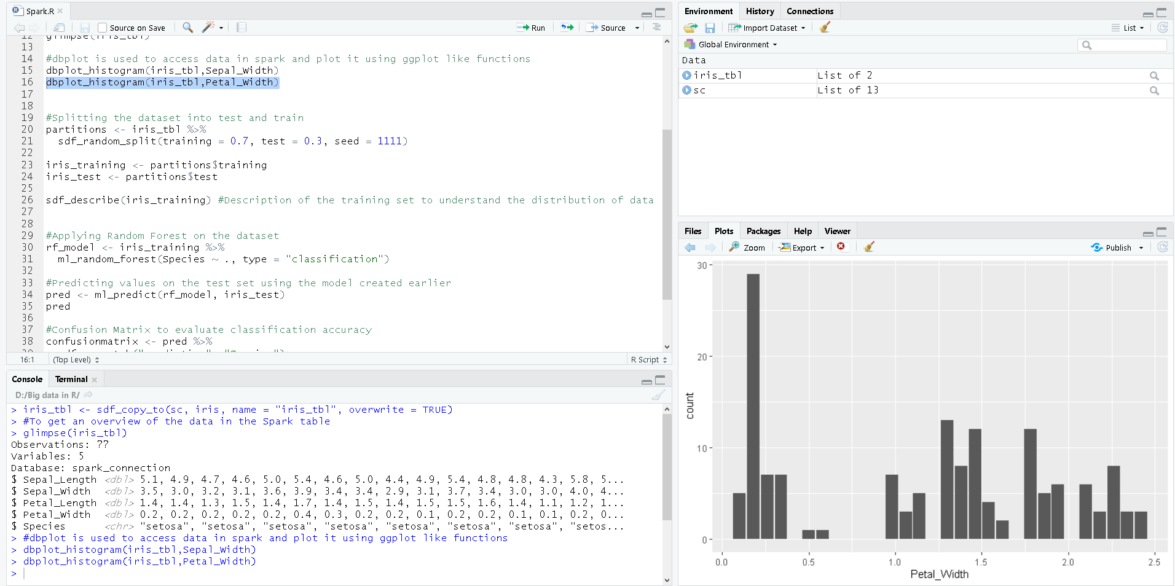
Exploratory Analysis(cont.)

Slide 22
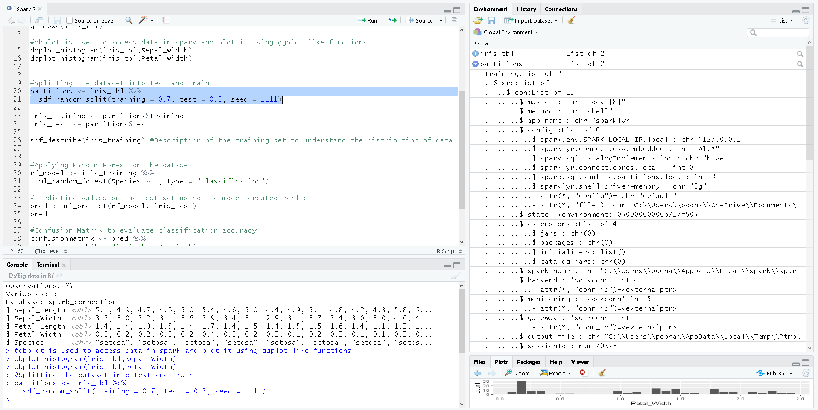
Partition the Dataset
Train – 70%
Test – 30%
sdf_random_split : Spark function to partition data

Slide 23
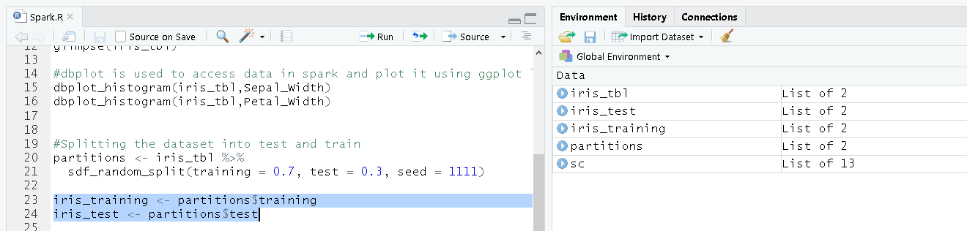
Local Variable
Assign local variables for Train and Test set

Slide 24
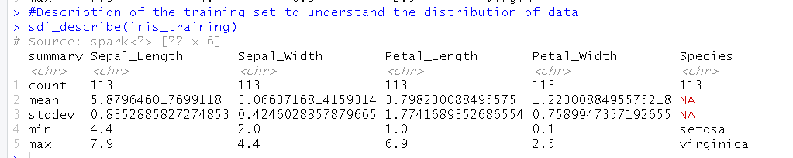
Describe Training dataset
sdf_describe: Spark function to describe the data

Slide 25
Apply Random Forest Model
ml_random_forest: Spark function to perform Random Forest algorithm

Slide 26
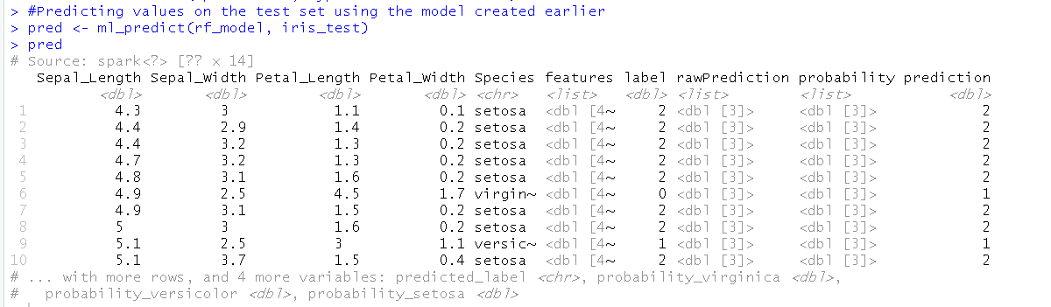
Prediction on Test set
ml_predict: Spark function to predict the response variable

Slide 27
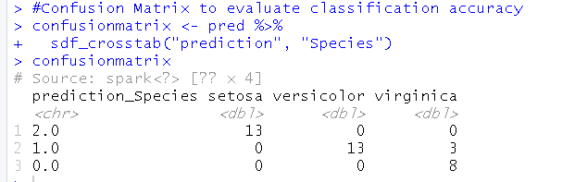

Evaluate model
sdf_crosstab: Spark function to create a table, used here to create the confusion matrix
ml_multiclass_classification_evaluator: Spark function to evaluate the performance of the machine learning model

Slide 28
Conclusion
The implementation of Big Data in R was successfully described using “sparklyr” library in R to connect to Apache Spark

